Slide 1

Intro To Supervised Learning
Class 3: From Linear Models to K-Nearest Neighbors. Finding the sweet spot between simplicity and complexity in supervised learning models.
AI BOOTCAMP

Slide 2
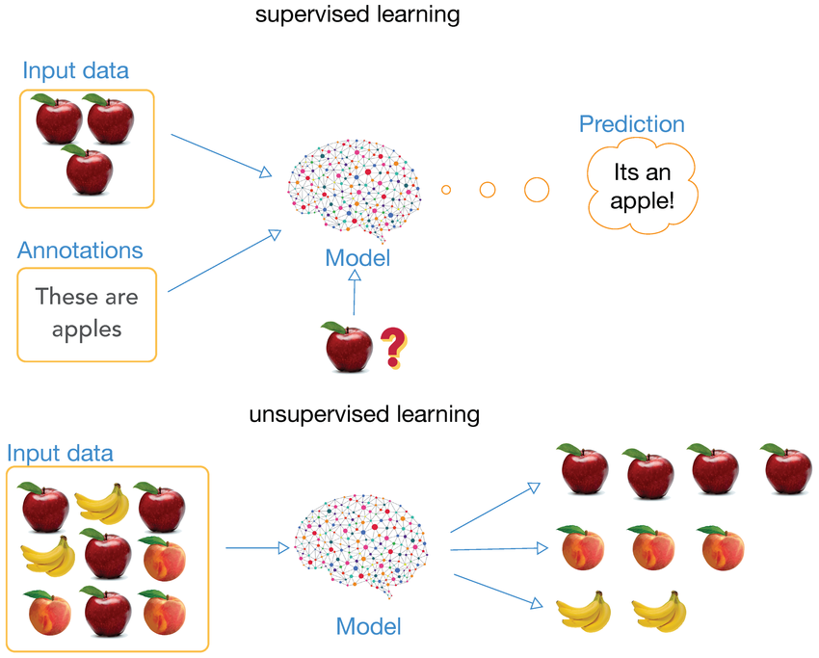

Slide 3

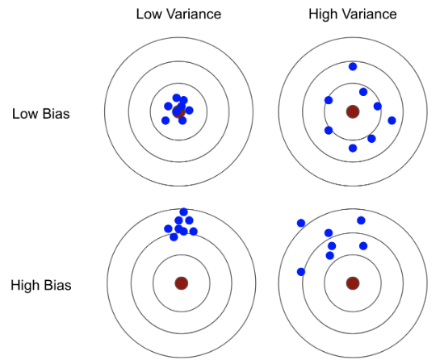
Finding the "Best" Model
The Estimator's Dilemma
An "Estimator" is just our guess at how the world works. To make a good guess, we must fight two enemies:
•
Bias: Our model is too “naive" or simple. It misses the real patterns (Underfitting).
•
Variance: Our model is too "reactive." it treats even random noise as real patterns (Overfitting).
Our goal is to minimize MSE (Mean Squared Error), which is just Bias² + Variance (Regression).
Notes:
-If the model has Low Bias and high Variance it would do perfectly on the training data which means it would also capture the noise
(Noise in the context of Ai means errors in data like typos in values 1,000 instead of 10,000 or misclassifications).
-If the model has high bias and low variance it would be too general it can t fit some specific data.
-Bias is about whether you are aiming at the right spot (the bullseye).
-Variance is about how much your hand shakes when you throw.

Slide 4
Regression
Predicting "How much?"

Slide 5

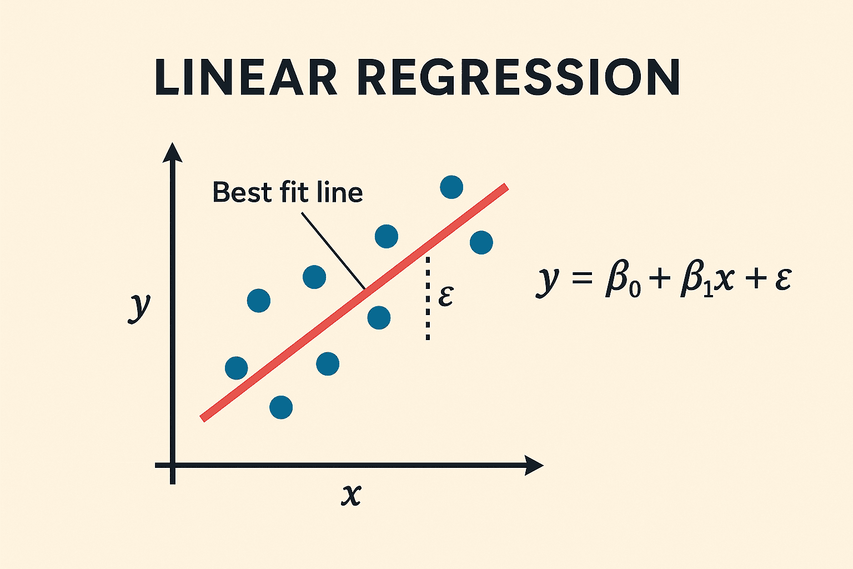
Linear Regression: Predicting Values
The "Best Fit" Line
Used when we want to predict a continuous number (like price, height, or temperature).
Finds the line that stays closest to all points.
Easy to interpret: "For every 1 unit increase in X, Y goes up by β."
Example: Predicting Exam score based on hours studied.

Slide 6
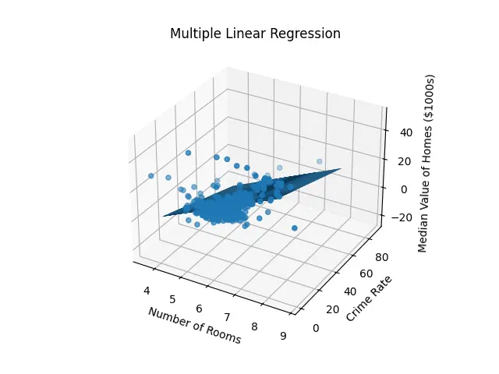
Linear Regression: Predicting Values
The "Best Fit" Line
Used when we want to predict a continuous number (like price, height, or temperature).
Two or more Independent variables.
Multicollinearity instead of collinearity.
Example: Predicting House price based on Sqft, Age and number of bedrooms.

Slide 7
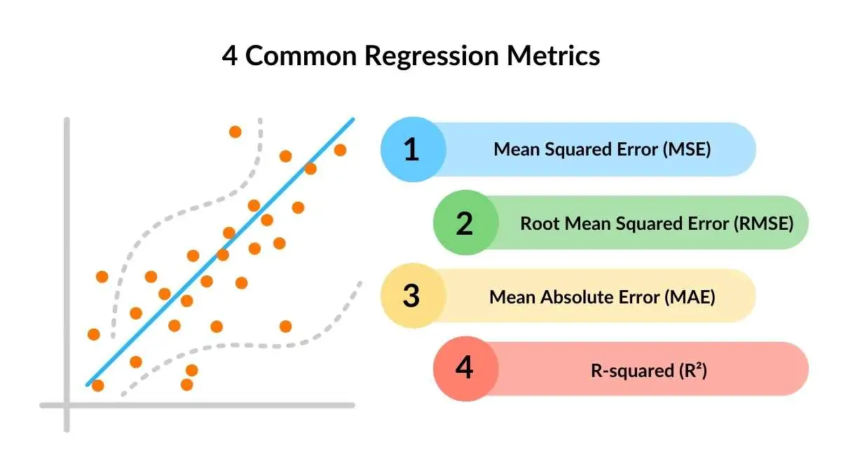

Slide 8
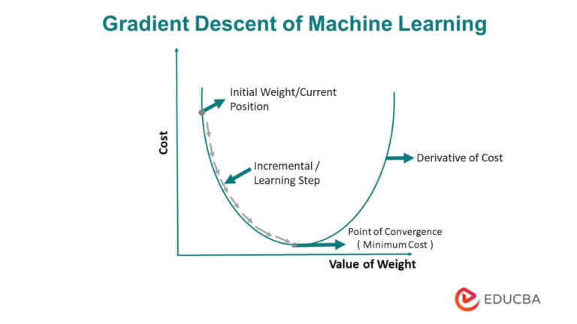

Slide 9




Regularization: Simple is Better
Ridge (L2)
Lasso (L1)
The "Balanced" approach. It keeps all your features but shrinks their importance. It prevents any single feature from dominating the result.
The "Minimalist" approach. It actively kills off useless features by setting their weights to zero. It's like an automated feature selector.
Notes:
-This is done during Gradient Descent.
-It prevents the model from overfitting.
-You can see it as a speed limit to stop the model from overreacting to noise.

Slide 10
Classification
Moving from predicting "How much?" to predicting "Which one?"

Slide 11
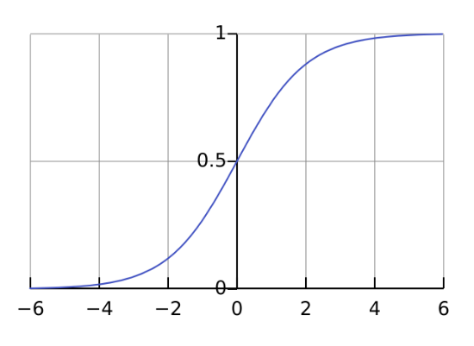

Logistic Regression: Probabilities
The S-Curve (Sigmoid)
Instead of a straight line, we use a curve to make all predictions range between 0 and 1.
This allows us to treat the output which can be a classification as a probability: "There is an 85% chance this email is Spam."

Slide 12
Logistic Regression: Probabilities
Cross Entropy Loss
Instead of using MSE for instance, we use cross entropy which measures the confidence of our classification instead of the distance we’re far from the correct observed output which is irrelevant in this case.
CE=-log(p)
Notes:
MSE is like a teacher who takes off one point for every mistake. Cross-Entropy is like a teacher who gives you a tiny penalty for a small error, but a massive failing grade if you are 100% confident in a totally wrong answer.

Slide 13
Is it Spam or Not?
How Logistic Regression cleans your Inbox:
Feature Extraction: It counts frequencies of trigger words like "FREE," "WIN," and "URGENT."
Weighting: The model learns that "FREE" has a high weight for Spam, while "Meeting" has a low weight.
Thresholding: If the probability is > 0.5, send it to the Spam folder. You can change this threshold to be more or less strict (we will see it in the code!)

Slide 14
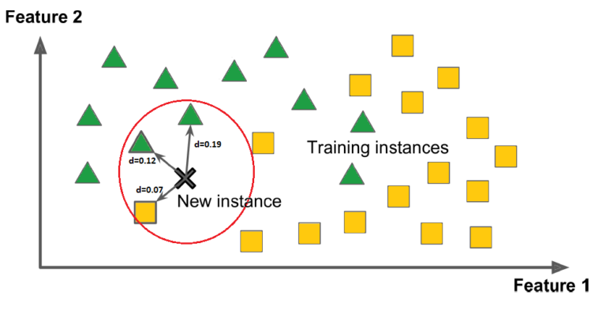
Nearest Neighbor

Slide 15
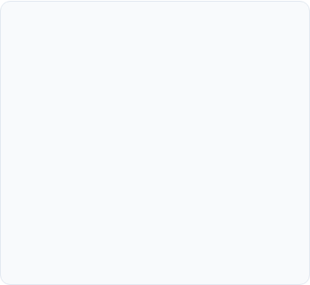
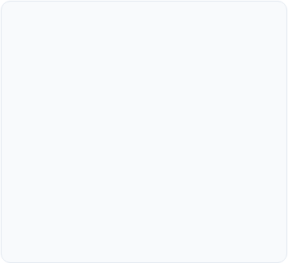
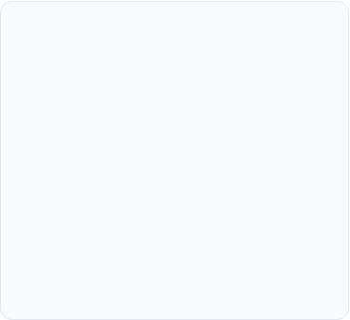



K-Nearest Neighbors (K-NN)
Similarity
The "Vote"
No Training
"Tell me who your friends are, and I'll tell you who you are." Data points of the same class tend to cluster together.
Pick a number K. Look at the K closest neighbors. The majority class wins the prediction.
K-NN is "lazy." It doesn't learn a formula; it just remembers all the data and searches through it when asked.
Notes:
-No Error Metric like MSE or Cross-Entropy it just uses Distance from all historical Data points.
-Choice of K symbolizes Bias-Variance Tradeoff.
-K-NN can be used for recommendation systems for instance.

